Slide 1
Link Prediction – Random walk based approaches

Slide 2
Markov Chain Example: Mouse in a cage

Slide 4
Simple Random Walk

Slide 5
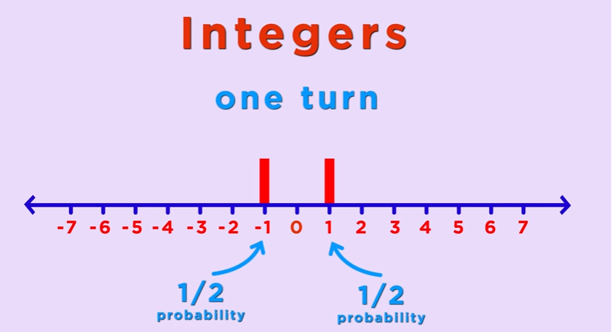

Slide 6


Slide 7
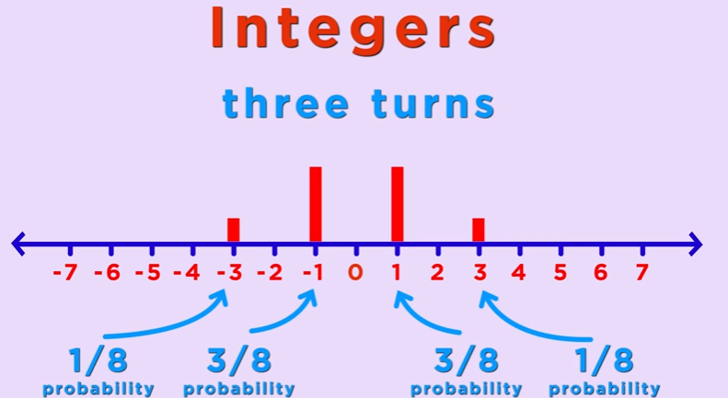

Slide 8


Slide 9
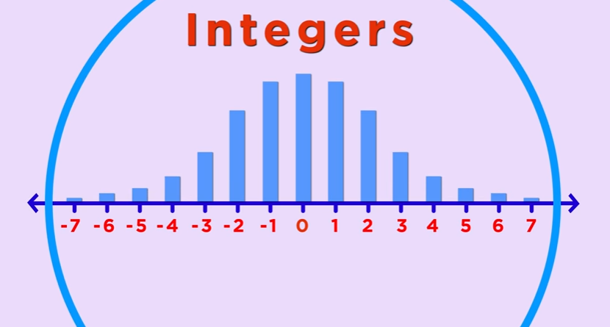

Slide 10
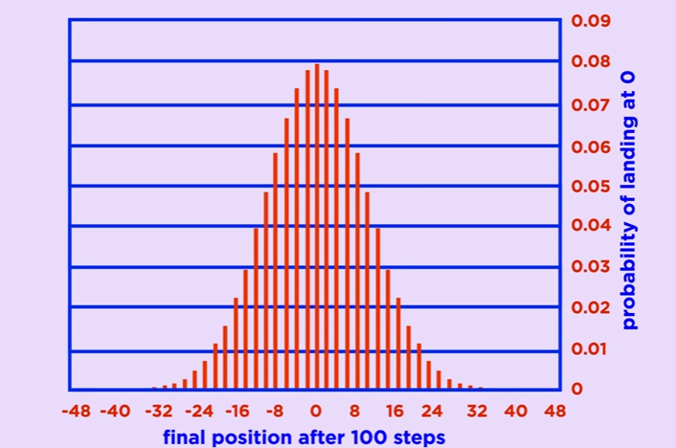

Slide 11
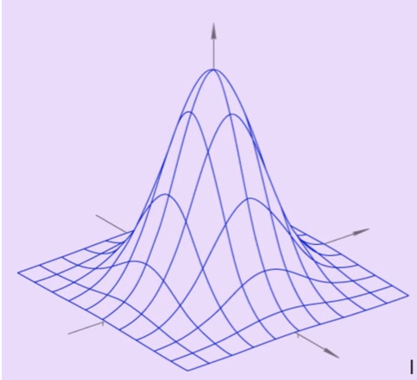
Simple Random Walk in a city

Slide 12
Actuarial chains

Slide 13
Definition of Markov Property

Slide 15
Transition Probability and Initial Distribution

Slide 16
Time Homogeneous chains

Slide 18
Hitting time

Slide 22
Pagerank Algorithm

Slide 23
Simple recursive formulation
Each link’s vote is proportional to the importance of its source page
If page P with importance x has n outlinks, each link gets x/n votes
Page P’s own importance is the sum of the votes on its inlinks

Slide 24
Simple “flow” model
y = y /2 + a /2
a = y /2 + m
m = a /2
Yahoo
y/2
y
a/2
y/2
m
Amazon
M’soft
a/2
a
m

Slide 25
Solving the flow equations
3 equations, 3 unknowns, no constants
No unique solution
All solutions equivalent modulo scale factor
Additional constraint forces uniqueness
y+a+m = 1
y = 2/5, a = 2/5, m = 1/5
Gaussian elimination method works for small examples, but we need a better method for large graphs

Slide 26
Matrix formulation
Matrix M has one row and one column for each web page
Suppose page j has n outlinks
If j ! i, then M_{ij}=1/n
Else M_{ij}=0
M is a column stochastic matrix
Columns sum to 1
Suppose r is a vector with one entry per web page
r_{i} is the importance score of page i
Call it the rank vector
|r| = 1

Slide 27
Example
Suppose page j links to 3 pages, including i
j
i
i
=
1/3
M
r
r

Slide 28
Eigenvector formulation
The flow equations can be written
r = Mr
So the rank vector is an eigenvector of the stochastic web matrix
In fact, its first or principal eigenvector, with corresponding eigenvalue 1

Slide 29
Example
y a m
Yahoo
y 1/2 1/2 0
a 1/2 0 1
m 0 1/2 0
r = Mr
Amazon
M’soft
y 1/2 1/2 0 y
a = 1/2 0 1 a
m 0 1/2 0 m
y = y /2 + a /2
a = y /2 + m
m = a /2

Slide 30
Power Iteration method
Simple iterative scheme (aka relaxation)
Suppose there are N web pages
Initialize: r⁰ = [1/N,….,1/N]^{T}
Iterate: r^{k+1} = Mr^{k}
Stop when |r^{k+1} - r^{k}|₁ < ε
|x|₁ = ∑_{1≤i≤N}|x_{i}| is the L1 norm
Can use any other vector norm e.g., Euclidean

Slide 31
Power Iteration Example
Yahoo
y a m
y 1/2 1/2 0
a 1/2 0 1
m 0 1/2 0
Amazon
M’soft
y
a =
m
1/3
1/3
1/3
1/3
1/2
1/6
5/12
1/3
1/4
3/8
11/24
1/6
2/5
2/5
1/5
. . .

Slide 32
Random Walk Interpretation
Imagine a random web surfer
At any time t, surfer is on some page P
At time t+1, the surfer follows an outlink from P uniformly at random
Ends up on some page Q linked from P
Process repeats indefinitely
Let p(t) be a vector whose i^{th} component is the probability that the surfer is at page i at time t
p(t) is a probability distribution on pages

Slide 33
The stationary distribution
Where is the surfer at time t+1?
Follows a link uniformly at random
p(t+1) = Mp(t)
Suppose the random walk reaches a state such that p(t+1) = Mp(t) = p(t)
Then p(t) is called a stationary distribution for the random walk
Our rank vector r satisfies r = Mr
So it is a stationary distribution for the random surfer

Slide 34
Spider traps
A group of pages is a spider trap if there are no links from within the group to outside the group
Random surfer gets trapped
Spider traps violate the conditions needed for the random walk theorem

Slide 35
Microsoft becomes a spider trap
Yahoo
y a m
y 1/2 1/2 0
a 1/2 0 0
m 0 1/2 1
Amazon
M’soft
y
a =
m
1
1
1
1
1/2
3/2
3/4
1/2
7/4
5/8
3/8
2
0
0
3
. . .

Slide 36
Random teleports
The Google solution for spider traps
At each time step, the random surfer has two options:
With probability β, follow a link at random
With probability 1-β, jump to some page uniformly at random
Common values for β are in the range 0.8 to 0.9
Surfer will teleport out of spider trap within a few time steps

Slide 37
Random teleports (β = 0.8)
0.2*1/3
y
y
y
1/2
Yahoo
y 1/2
a 1/2
m 0
1/2
1/2
0
1/3
1/3
1/3
0.8*1/2
0.8*
+ 0.2*
1/2
0.8*1/2
0.2*1/3
0.2*1/3
1/2 1/2 0
1/2 0 0
0 1/2 1
1/3 1/3 1/3
1/3 1/3 1/3
1/3 1/3 1/3
Amazon
M’soft
0.8
+ 0.2
y 7/15 7/15 1/15
a 7/15 1/15 1/15
m 1/15 7/15 13/15

